Slide 1

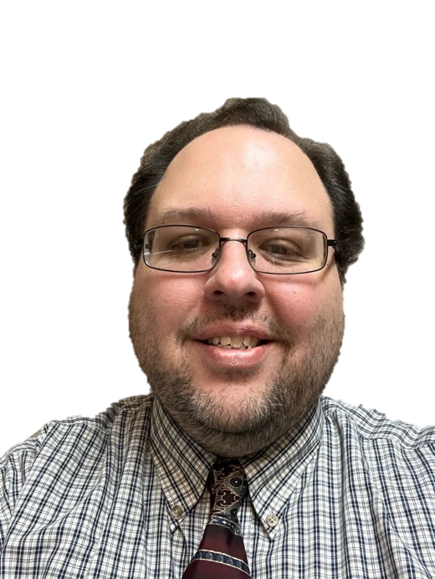

Join me for the
NATIONAL INJURY
PREVENTION DAY
Twitter/X Chat!
Friday
November 17th
1:00 pm EST
Join the conversation! Use hashtag
#BeInjuryFree

Slide 2
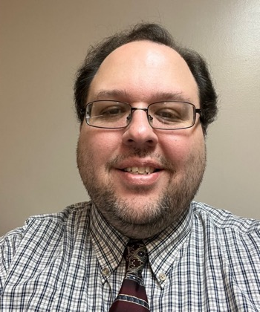

I’m going GREEN for
NATIONAL INJURY
PREVENTION DAY
November 18, 2023

Slide 3
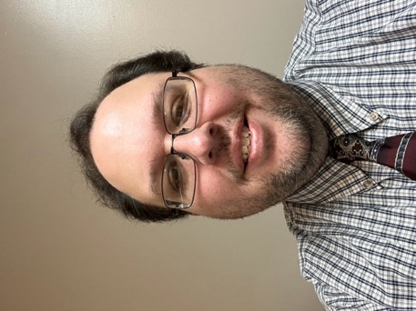

Shine a Green Light
for Injury Prevention!
Join me in celebrating
NATIONAL INJURY
PREVENTION DAY
this November 18th.
Learn more at injuryfree.org.

Slide 4
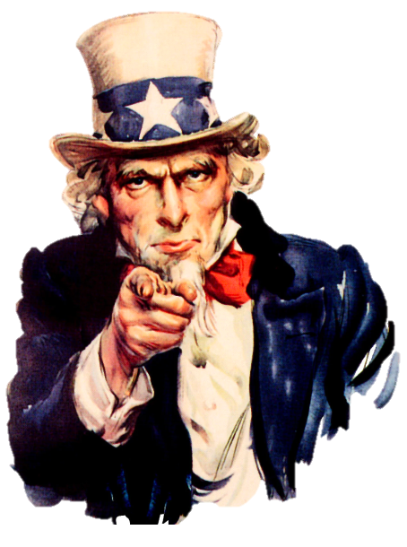

I WANT YOU
to #BeInjuryFree
National Injury Prevention Day
November 18, 2023

